Slide 1
Systematic Trading
With Trend Following Strategies
FRE7841 - Final Project
Presenter: Syed Ahzam Tariq (sat10045) Siying Gu (sg8015) Elvis Tsai (pt2296)
03/07/2024

Slide 2

Abstract
This project delves into the realm of quantitative trading strategies, leveraging historical data across a broad spectrum of asset classes including commodities, equities, fixed income, and currencies. Central to our strategy are three technical indicators: SMA Crossover, RSI, and MACD. A pivotal aspect of our strategy is the application of the Kelly Criterion for determining optimal bet sizes. By normalizing bet sizes to ensure full capital utilization, and rebalancing the portfolio daily in alignment with current positions, our strategy maintains agility and responsiveness to market dynamics. Furthermore, transaction costs are conservatively approximated for, varying across different securities in accordance with expert recommendations. Performance evaluation of our trading system is conducted through the lens of the Sharpe and Sortino ratios, offering insights into the system's risk-adjusted returns and its ability to navigate downside volatility. To gauge the robustness of our strategies under different market conditions our strategy is tested for 9 consecutive years.
Notes:
"Today, we will dive into a comprehensive analysis of a trading strategy that combines multiple indicators. We will explore the strategy's backtesting performance on historical data and its robustness through bootstrapping simulations."

Slide 3
Procedure | Principle of Strategy
We develop a trading strategy that incorporates three distinct technical indicators.
Our strategy spans across multiple asset classes, including Equities, Commodity Futures, Currencies, and Fixed Income Securities, selecting several assets within each class.
Our analysis covers a total of nine consecutive years for strategy testing, with the year preceding each used to tailor parameters for each asset individually. This training period also serves to derive data for determining bet sizes based on the Kelly Criterion.
To fully leverage our capital, bet sizes are adjusted to a normalized value of 1.
The portfolio undergoes daily rebalancing to reflect the latest positions and transaction costs arising from these daily-rebalancing is also incorporated into transaction costs.
Different transaction costs are used for each asset as advised.
We evaluate our trading system's efficacy using the Sharpe and Sortino ratios.
Kindly Note that our Jupyter notebook takes 1.5+ hours to execute since it optimises all the parameters for each period and every asset and every strategy

Slide 4
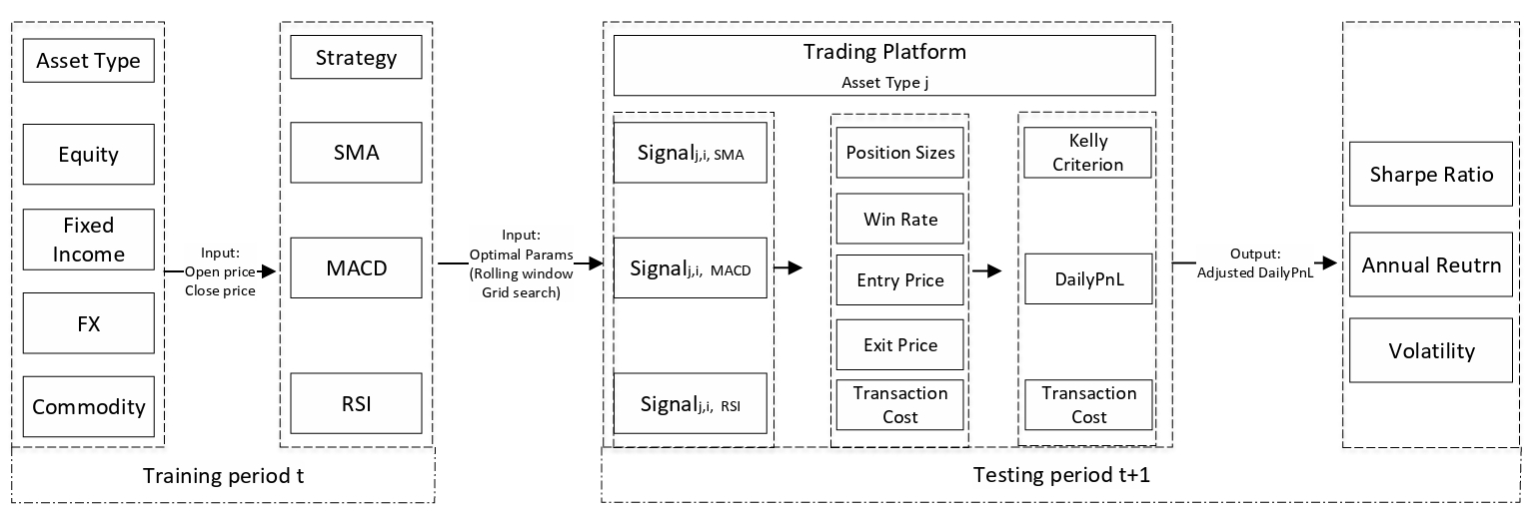
Procedure | Flow Chart

Slide 5
Asset Description
Asset Type | Asset description
Equity | Microsoft, Apple, Nvidia, Amazon, Alphabet, Meta, Elli Lily, Tesla, Broadcom, Visa, TSMC, Novo Nordisk, JPMorgan, ASML, P&G, Merck, Costco, Home Depot, nJ, UnitedHealth Group, Walmart, Mastercard, Exxon Mobil
Fixed Income | WN1 (UST 30y), TY1 (10y US Treasury), FV1 (5y US Treasury)
FX | EURUSD, GBPUSD, AUDUSD, NZDUSD, USDCHF, USDMYR, EURCZK, USDHKD, USDTWD, USDRUB, USDJPY, USDNOK, USDMXN
Commofities | Gasoline (XB1), Brent (CO1), Coffee(KC1), Gold (GC1), Sugar (SB1), Corn (C1), Natural Gas (NG1), Wheat (W1)

Slide 6
Methodology | Simple Moving Average (SMA) Crossover Strategy
The strategy utilizes the SMA function to compute the simple moving average of closing prices over two different periods, n1 and n2, representing short-term and long-term moving averages, respectively.
The class SmaCross inherits from Strategy. It precomputes two SMAs in the init method and decides on the trading action in the next method.
A buy signal is generated when the short-term SMA crosses above the long-term SMA, indicating an upward trend. Conversely, a sell signal is generated when the short-term SMA crosses below the long-term SMA, indicating a downward trend.

Slide 7
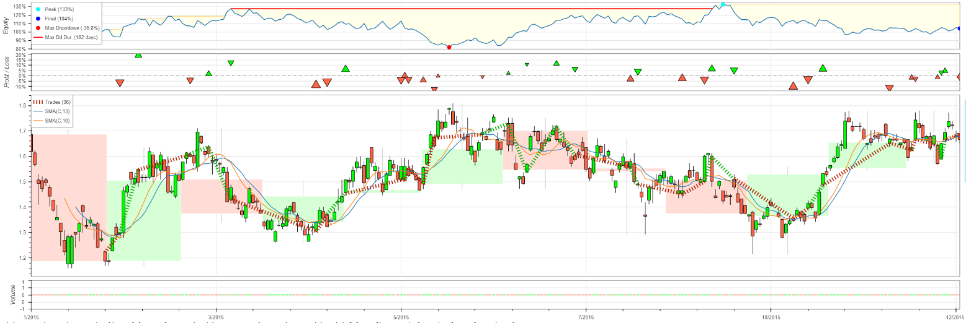
Methodology | SMA Backtesting Graph
Figure: Backtesting result of asset LLY on SMA signal, from 2015 to 2016
Notes: For each single asset, we generate a backtesting graph for a parameter combination in a new period, in this SMA strategy, we took LLY as an example and plot the testing result of first period.

Slide 8
Methodology | RSI Trading Strategy
The intuition behind the RSI-based trading strategy revolves around capturing momentum reversals by identifying overbought and oversold conditions in the market.
Strategy Logic
Buying on Oversold Conditions: The strategy interprets an RSI value dropping below a lower threshold (n1) as an indicator that the asset is oversold. The assumption is that the asset's price has been pushed too low, and a reversal or correction is likely. Buying at this point aims to capture the potential upward swing as the market corrects the oversold condition.
Selling on Overbought Conditions: Conversely, when the RSI rises above a higher threshold (n1), it suggests the asset is overbought. The price may have risen too quickly, and a pullback or downward correction could be imminent. Closing positions or selling at this point is aimed at capitalizing on the expected downturn or at least protecting the profits from a potential reversal.
The values of N1 and N2 are initialised as 25 and 70 initially. However, it is optimised for every stock and values of N1 and N2 are stored which are used during the testing period

Slide 9
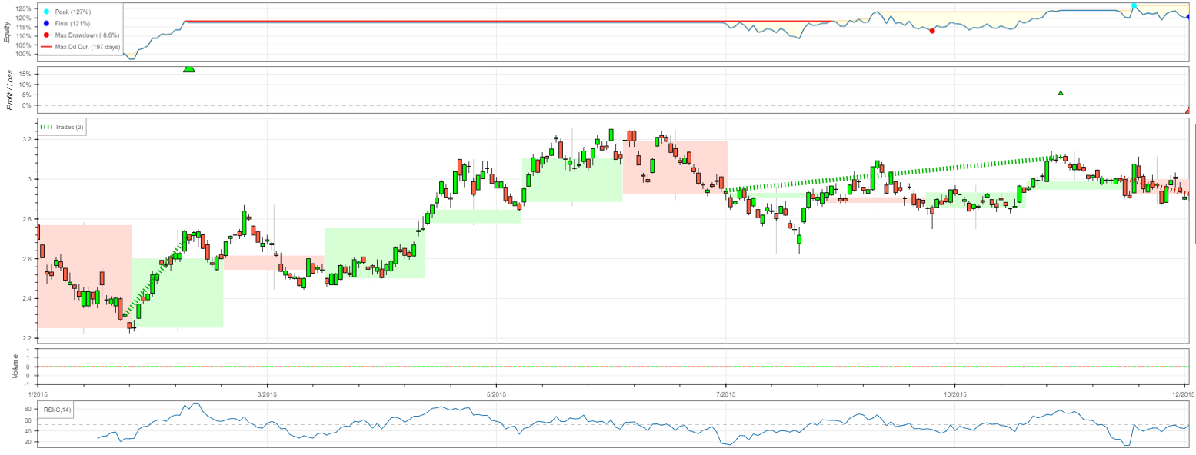
Methodology | RSI Backtesting Graph
Figure: Backtesting result of asset PG on RSI signal, from 2015 to 2016.
Notes: For each single asset, we generate a backtesting graph for a parameter combination in a new period. In this RSI strategy, we took PG as an example and plot the testing result of first period. Since the range of close price and RSI values are in different scale, in backtesting package the bt.plot() function will plot them into two graph section.

Slide 10
Methodology | MACD Trading Strategy
The MACD (Moving Average Convergence/Divergence) can be succinctly described as a technical indicator closely resembling the familiar Moving Average Crossover strategy. However, it distinguishes itself by employing exponentially weighted moving averages instead of equally weighted ones. Essentially, the MACD measures the relationship between two such moving averages of a security's price, aiding in trend identification, momentum assessment, and identification of market entry points for buying or selling securities.
Parameters:
Fast Period: The number of days for fast EMA calculation period; determines how quickly the MACD line reacts to price changes
Slow Period: The number of days for slow EMA calculation period; affects the smoothness and lag of the MACD line relative to price movements
Singal Period: Signal line calculation period; Influences the sensitivity of the trigger for entering or exiting trades
The values of Fast Period, Slow Period & Signal Period are optimised for each stock in the training period and the values are used in the testing period

Slide 11
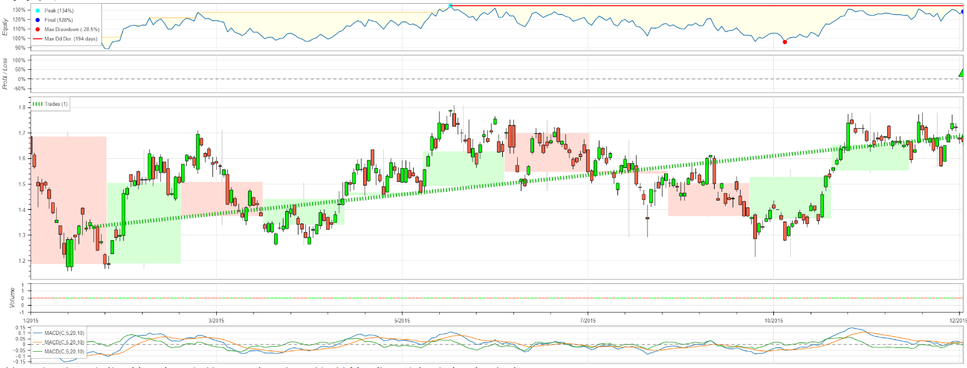
Methodology | MACD Backtesting Graph
Figure: Backtesting result of asset LLY on MACD signal, from 2015 to 2016.
Notes: For each single asset, we generate a backtesting graph for a parameter combination in a new period. In this MACD strategy, we took LLY as an example and plot the testing result of first period. Since the range of close price and MACD values are in different scale, in backtesting package the bt.plot() function will plot them into two graph section.

Slide 12
Portfolio Construction | Kelly-Criterion
In our strategy, we have used our training set to initialise our bet sizes as per the Kelly-Criterion and have allocated our capital in ratio using the Kelly Criterion
We have calculated the optimal bet sizes for each asset and for each strategy separately. So, if we have ɑ assets and 𝛃 strategies, then the number of kelly values are ɑ𝛃.
We have then normalized the kelly values so that they sum up to 1, signifying that each day we bet our complete capital
Our strategy makes independent bets as combining the three signals of RSI, MACD and SMA using an AND gate was resulting in very few transactions over a period of time and many assets were not trading at all. Nevertheless, we recognize that employing a composite signal might have led to a more conservative approach. Despite this, we opted to go ahead with independent bets.

Slide 13
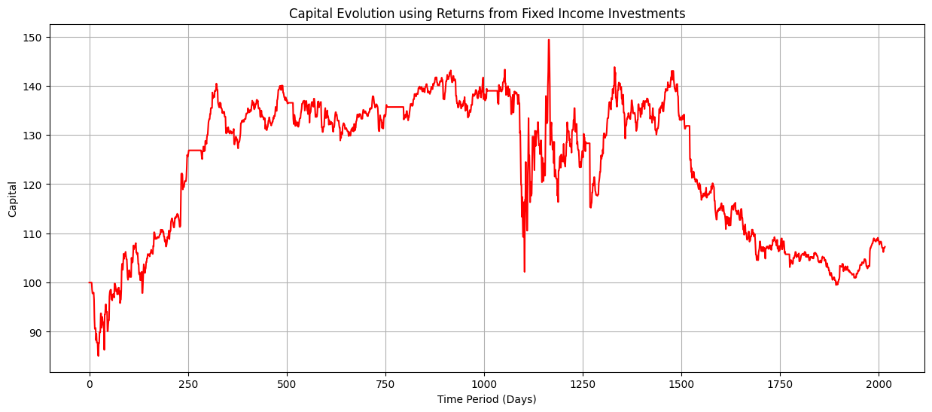
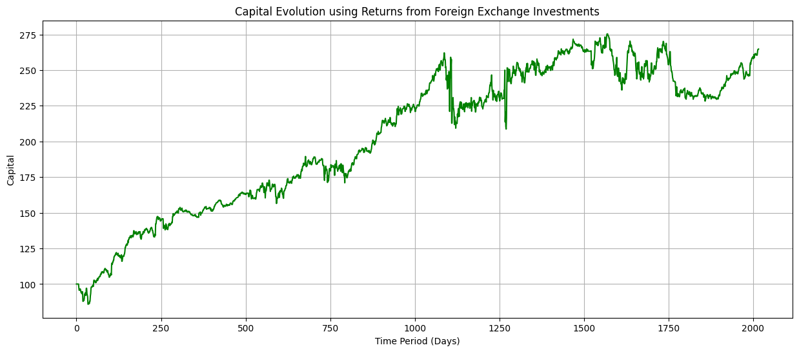
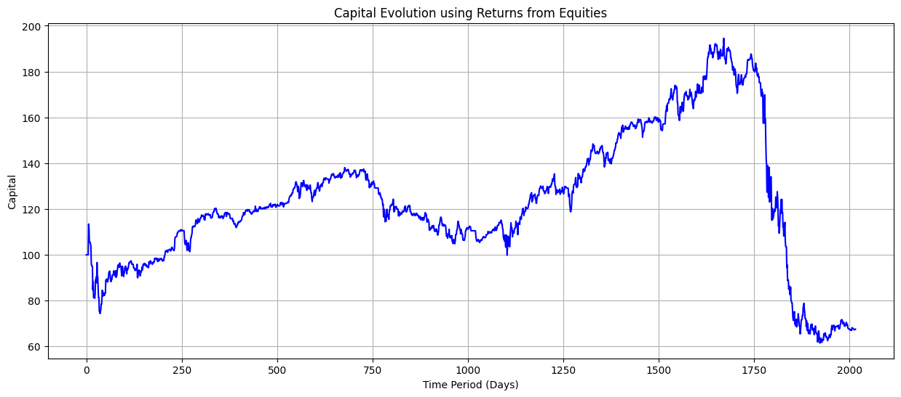
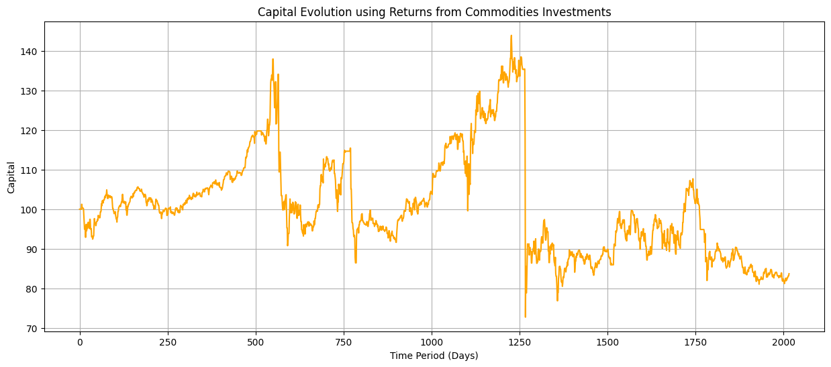
Trading results over the complete testing period - By Asset Class

Slide 14
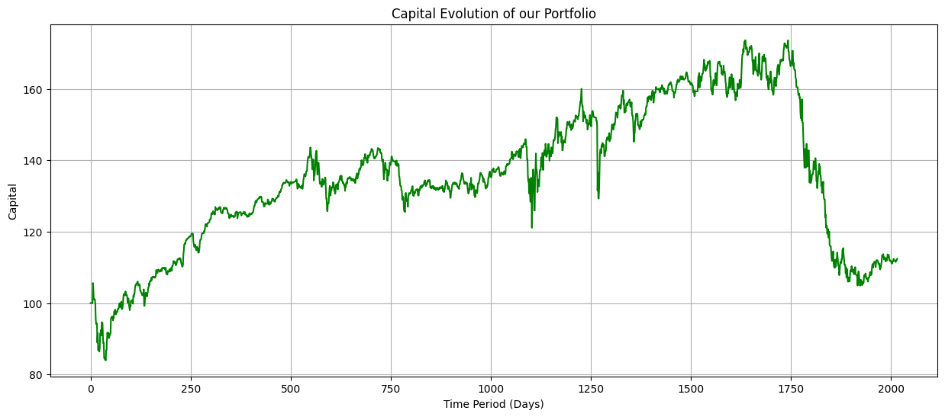
Trading results over the complete testing period - Complete Portfolio

Slide 15
Portfolio Construction | Results
Asset Class | Period | Annual Return | Volatility | Sharpe Ratio
Equities | First-Half | 2.53% | 20.29% | 0.02 -> 0.002
 | Second-Half | -11.59% | 28.36% | -0.49
 | Complete Testing Period | -4.78% | 24.65% | -0.29
Fixed Income | First-Half | 8.58% | 13.17% | 0.46
 | Second-Half | -6.23% ->-6.27% | 22.31% | -0.39
 | Complete Testing Period | 0.88% | 18.32% | -0.09
FX | First-Half | 22.55% | 16.10% | 1.25
 | Second-Half | 4.09% | 22.36% | 0.07
 | Complete Testing Period | 12.94% | 19.48% | 0.54
Commodities | First-Half | 1.97% | 19.04% | -0.03
 | Second-Half | -6.20% | 31.76% | -0.27
 | Complete Testing Period | -2.20% | 26.18% | -0.18
Portfolio | First-Half | 8.13% | 13.46% | 0.42
 | Second-Half | -4.77% | 19.73% | -0.37
 | Complete Testing Period | 1.47% | 16.89% | -0.06
Calculations assume a risk free rate of 2.5%

Slide 16
Results and Interpretation
We observe that our strategy yields positive returns during the first half of the testing period. However, the strategy does not perform well during the second half of the testing period.
Overall, Fixed Income and FX yield positive returns during the complete testing period. However, equities and commodities bring down our total portfolio returns.
We believe that having a proper risk management scheme can help avoid large loses in commodities and equities which will certainly enhance the portfolio returns.

Slide 17
Conclusion
Our project delves into quantitative trading strategies across diverse asset classes—commodities, equities, fixed income, and currencies—leveraging three key technical indicators: SMA Crossover, RSI, and MACD. Central to our methodology is the Kelly Criterion for optimizing bet sizes, ensuring full capital deployment daily and a portfolio that's adaptable to market changes. We've carefully considered transaction costs, aligning with expert guidelines to enhance our financial modeling precision.
This refined investment framework emphasizes risk management and profit maximization, offering investors tools for achieving superior outcomes in CTA. Further details on our strategic asset allocation, crucial for boosting our portfolio's performance, are presented in the Appendix, highlighting our disciplined investment approach.

Slide 18
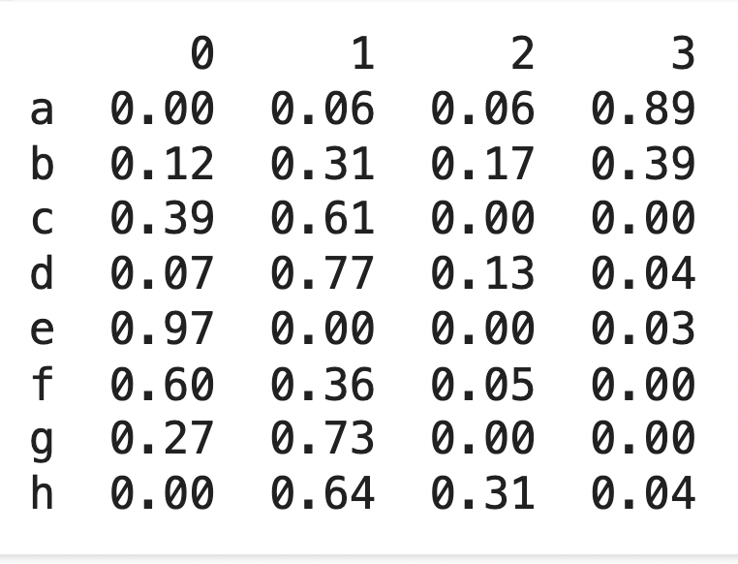
Appendix
We have further applied the methodology of the paper “Honey, I Shrunk the Sample Covariance Matrix” to assign weights to our asset class. However, it does appear effective as the weights of asset classes for consecutive periods vary significantly so the values obtained from previous periods cannot be considered optimal for the next. Therefore, we have not included the results from this part of our analysis as part of our main results.
Side Note: Each letter represents a group of four asset classes with
the same rolling period. And we could tell from the result, group b
might have the most ideal and balanced weight across the groups.
Notes:
"Today, we will dive into a comprehensive analysis of a trading strategy that combines multiple indicators. We will explore the strategy's backtesting performance on historical data and its robustness through bootstrapping simulations."

Slide 19
Thank You!

